Slide 1
Quantum Computing Architectures (EE274) Lecture 9
Hiu-Yung Wong
feb. 20, 2025
hiuyung.wong@sjsu.edu, Office: ENG363
http://www.sjsu.edu/people/hiuyung.wong/index.html

Slide 2
Outline
Decoherence Time
Schroedinger Equation
Spin

Slide 3
Density Matrix on Bloch Sphere
Chapter 6 of “Quantum Computing Architecture and Hardware for Engineers: Step by Step”
Introduction to Quantum Computing From a Layperson to a Programmer in 30 Steps – YouTube
https://www.youtube.com/playlist?list=PLnK6MrIqGXsJfcBdppW3CKJ858zR8P4eP

Slide 4
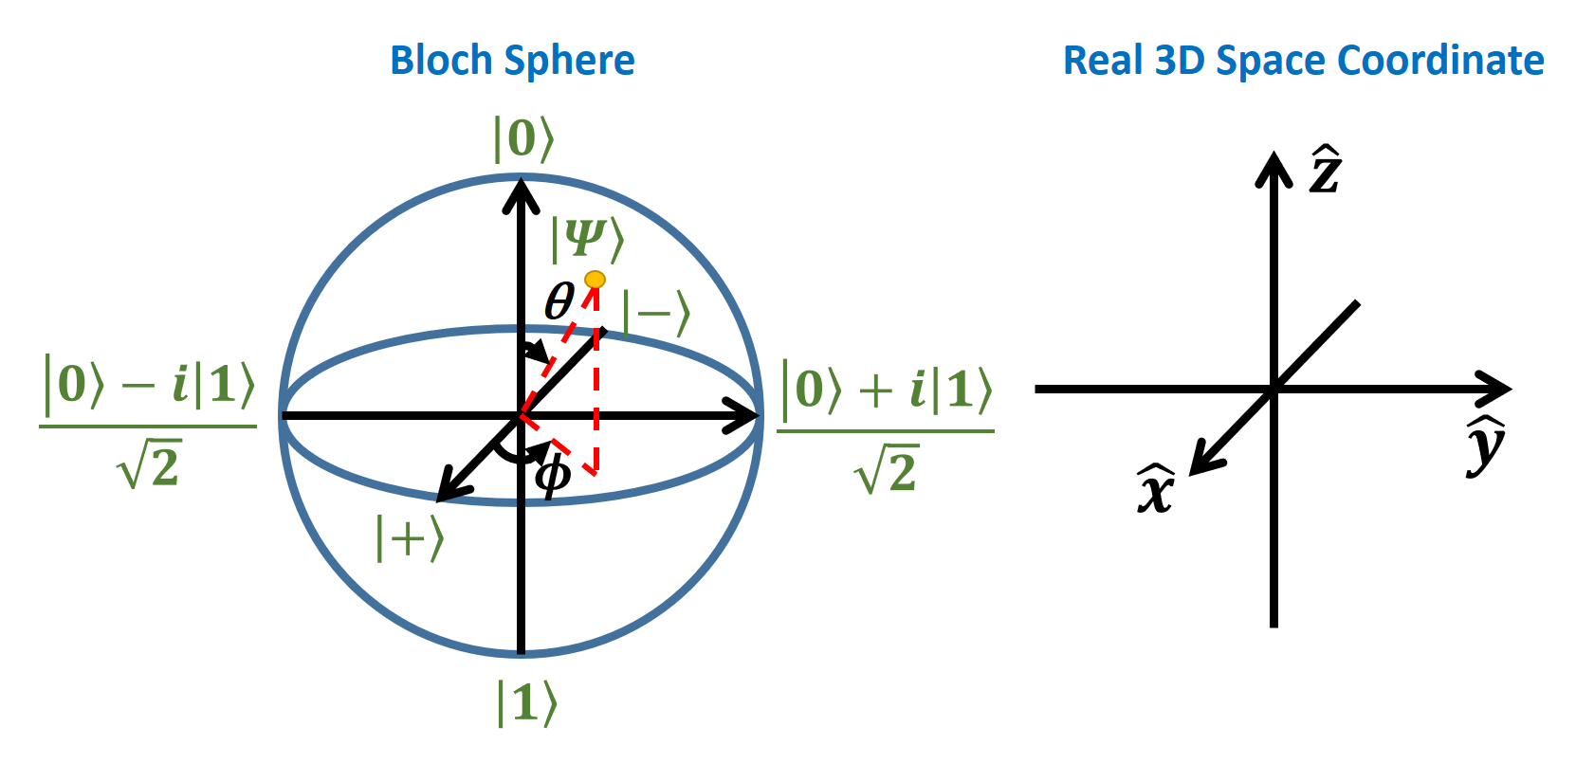
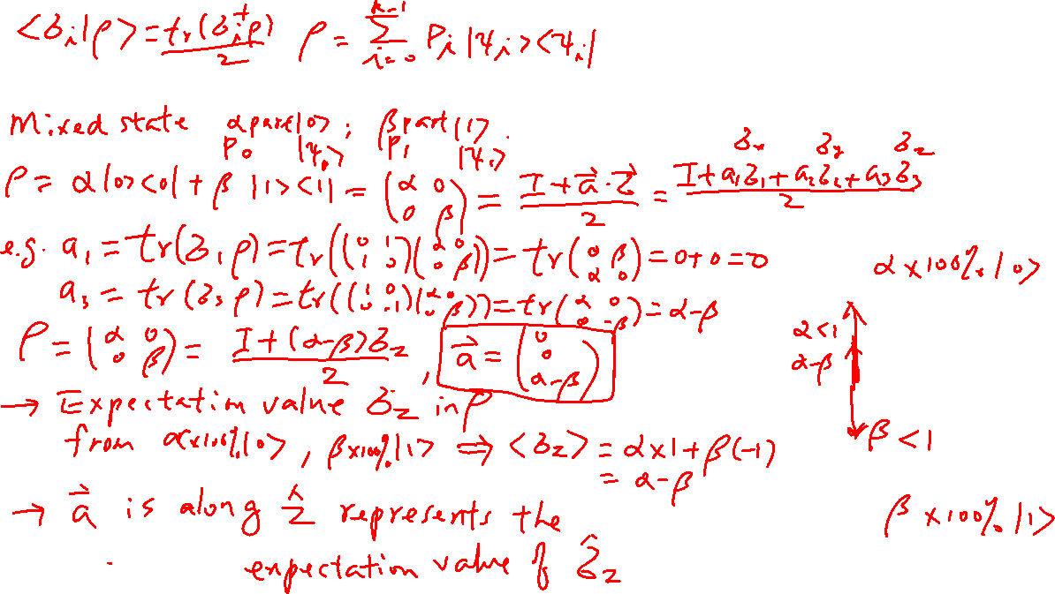
Mixed State – a simple example
Learning outcomes: Understand how map a mixed state to Bloch sphere

Slide 5
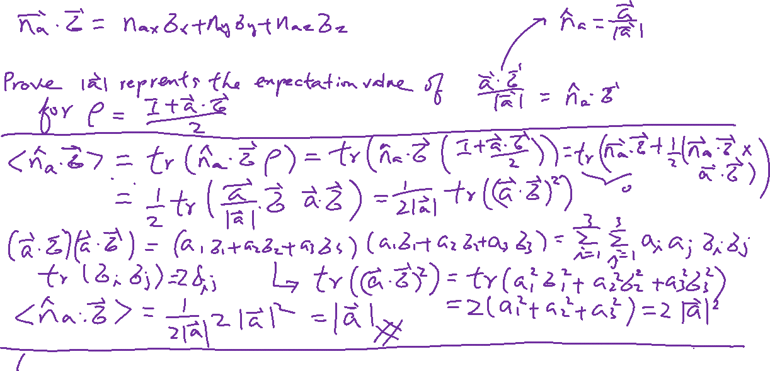
Mixed State – General example
Learning outcomes: Understand how map a mixed state to Bloch sphere

Slide 6
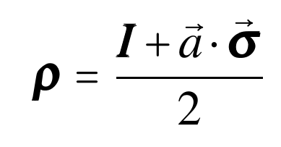
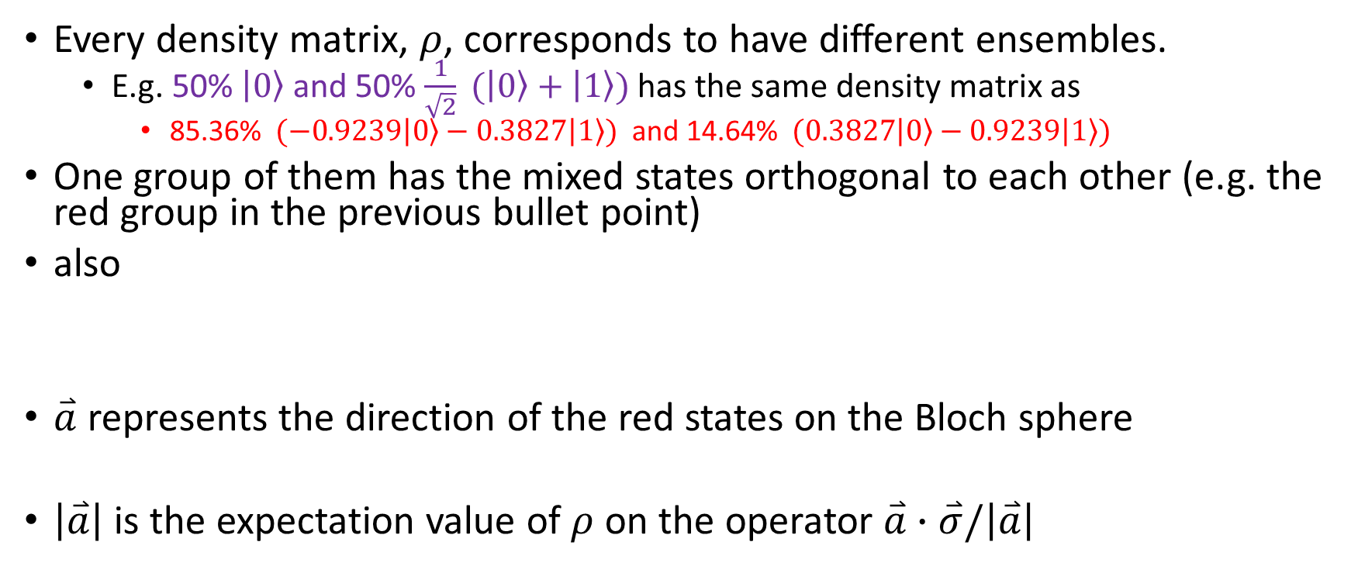
Summary of the relationship between the Mixed State Density Matrix and Bloch Sphere
Every density matrix, $ρ$, corresponds to have different ensembles.
E.g. 50% $\left.\left|0\right.\right\rangle$ and 50% $\frac{1}{\sqrt{2}}\left. (\left|0\right.\right\rangle +\left.\left|1\right.\right\rangle )$has the same density matrix as
85.36% $\left. (−0.9239\left|0\right.\right\rangle −0.3827\left.\left|1\right.\right\rangle )$ and 14.64% $\left. (0.3827\left|0\right.\right\rangle −0.9239\left.\left|1\right.\right\rangle )$
One group of them has the mixed states orthogonal to each other (e.g. the red group in the previous bullet point)
also
$\overset{⃑}{a}$ represents the direction of the red states on the Bloch sphere
$\left|\overset{⃑}{a}\right|$ is the expectation value of $ρ$ on the operator $\overset{⃑}{a}∙\overset{⃑}{σ}/\left|\overset{⃑}{a}\right|$

Slide 7
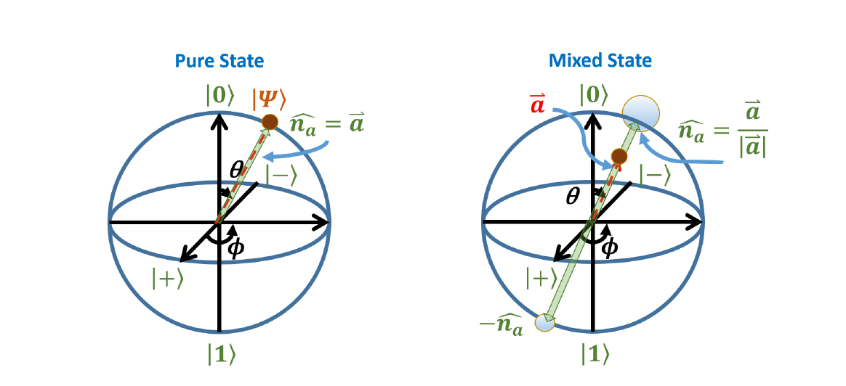
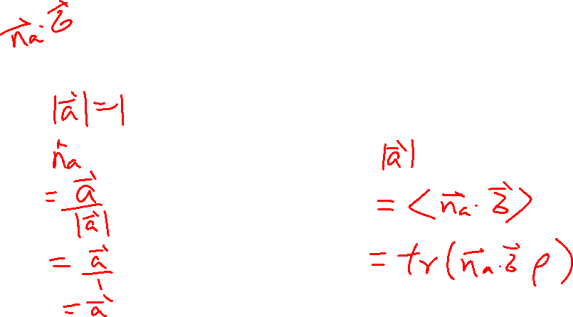
Mixed State – a general example
Learning outcomes: Understand how map a mixed state to Bloch sphere

Slide 8
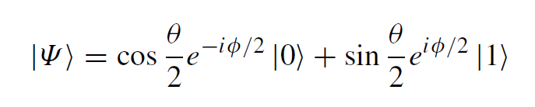


Summary
Expectation value
Density Matrix of a qubit (we will use a to replace a’ for now)

Slide 9
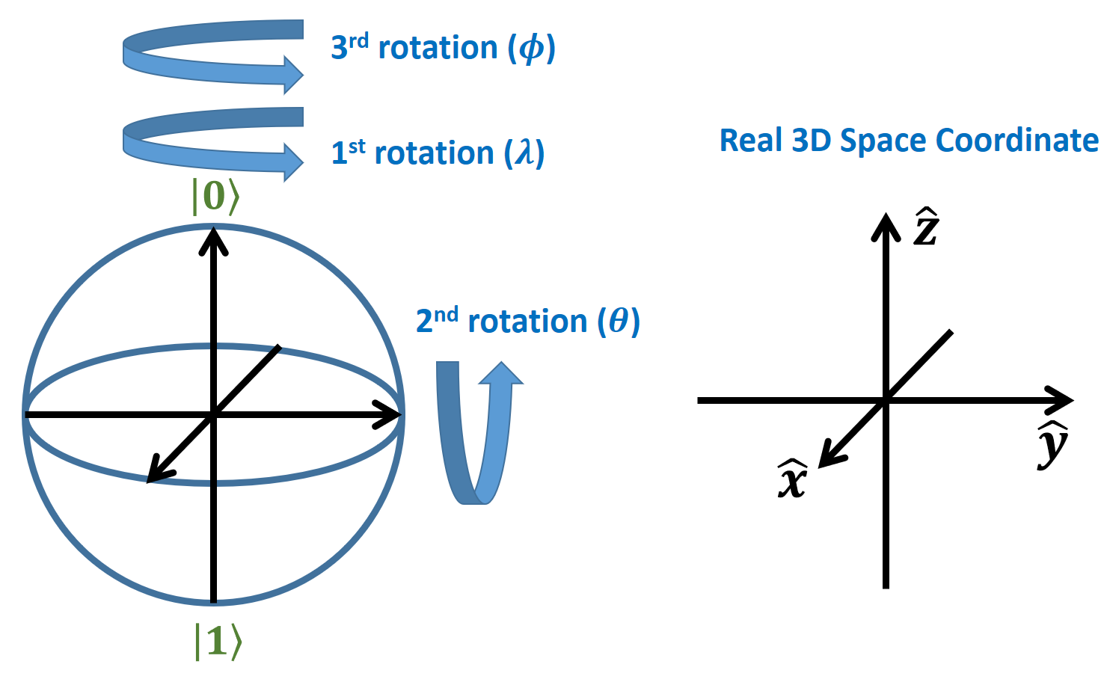
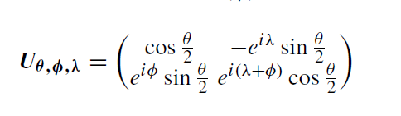
Summary

Slide 10
Decoherence
Chapter 25 of “Quantum Computing Architecture and Hardware for Engineers: Step by Step”
Introduction to Quantum Computing From a Layperson to a Programmer in 30 Steps – YouTube
https://www.youtube.com/playlist?list=PLnK6MrIqGXsJfcBdppW3CKJ858zR8P4eP

Slide 11

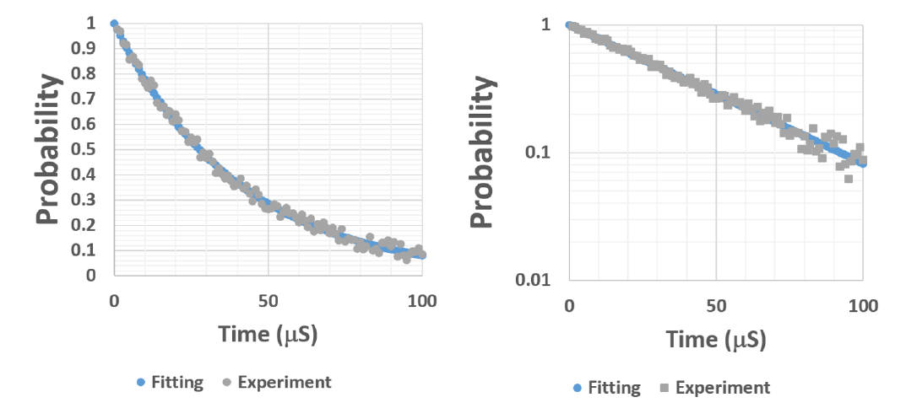
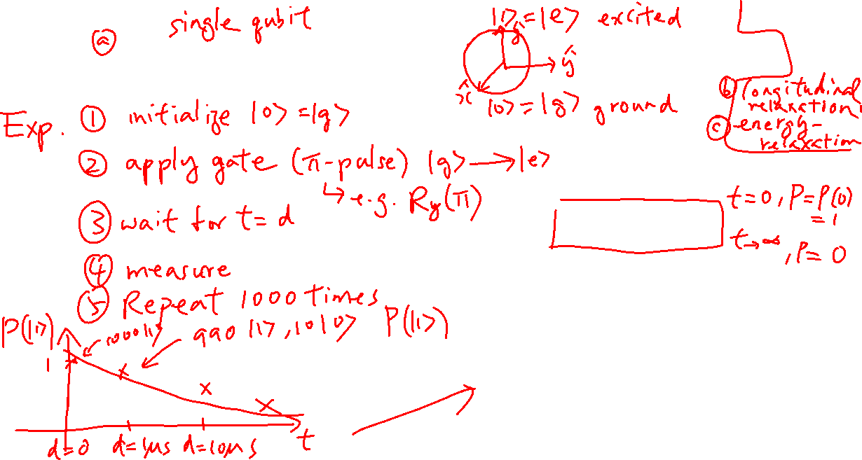
T₁ – Relaxation Time
Learning outcomes: Properties of the density matrix of qubit

Slide 12
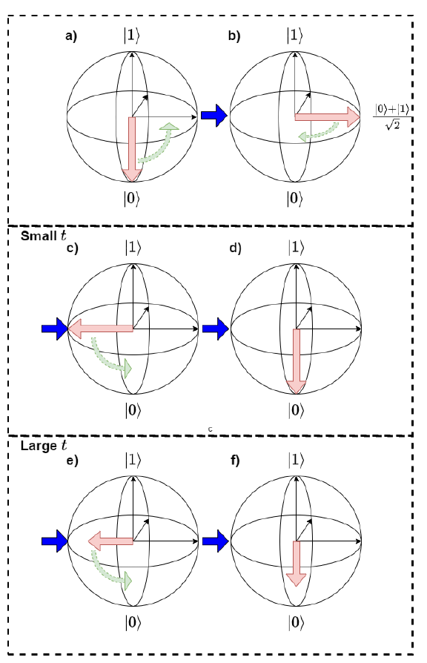
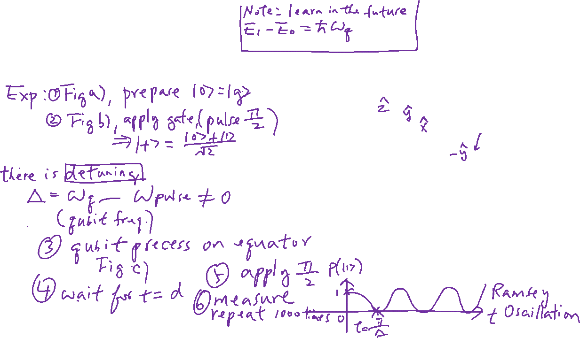
Ramsey Oscillation
Learning outcomes: Properties of the density matrix of qubit

Slide 13

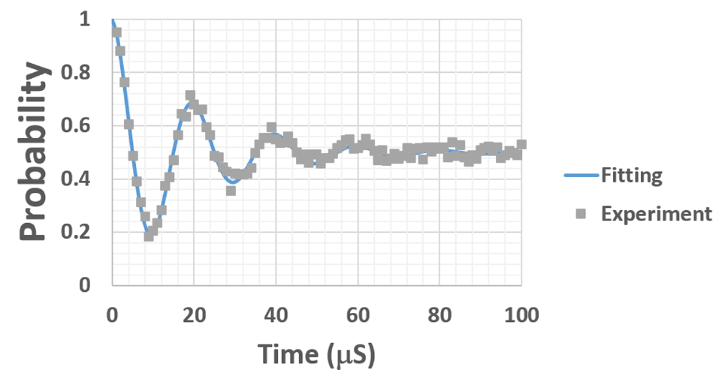
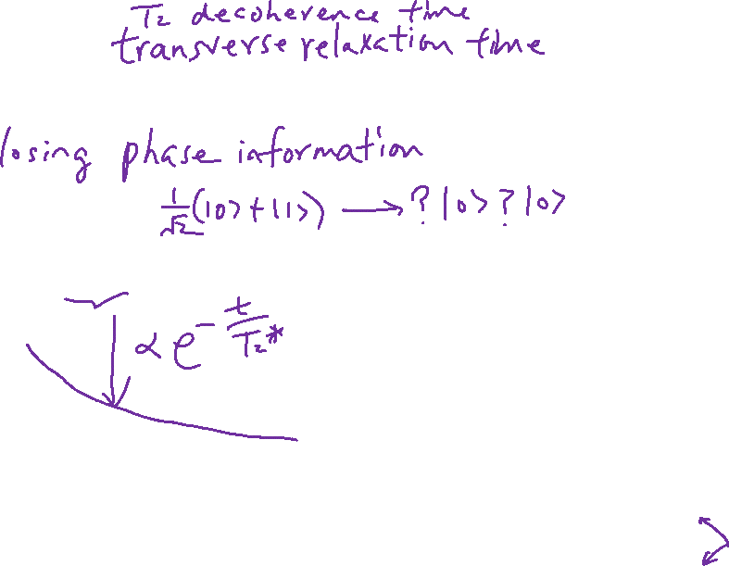
T₂ = T_{Φ} Dephasing Time

Slide 14

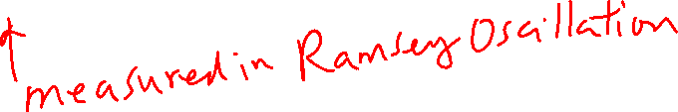
T₂* Time
When measuring T₂, T₁ has effect also
What we are measuring is actually
$$\frac{1}{T^{∗}}=\frac{1}{2T_{1}}+\frac{1}{T_{2}}$$

Slide 15

Spin Echo
Spin echo - Wikipedia

Slide 16
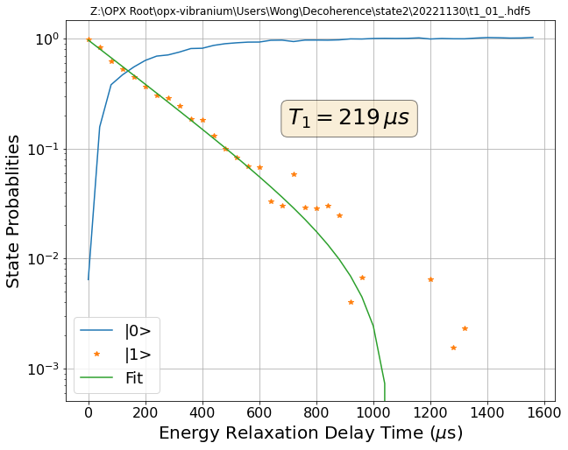
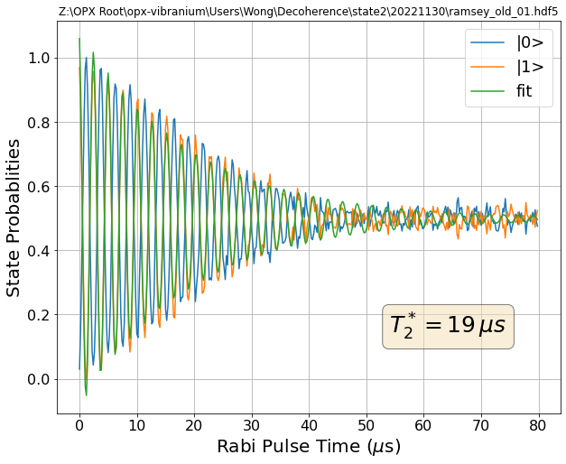
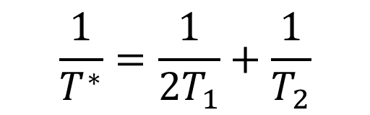
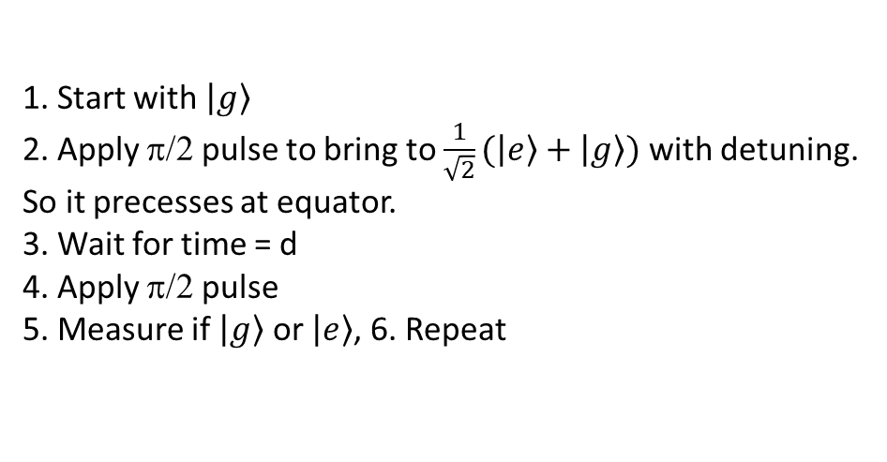
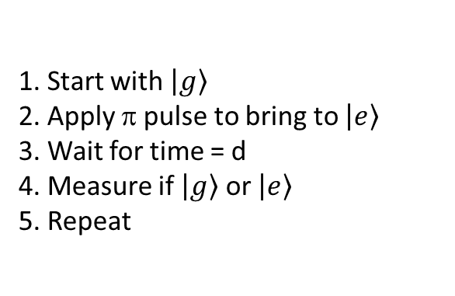
Summary: Decoherence Time
1. Start with $\left.\left|g\right.\right\rangle$
2. Apply π/2 pulse to bring to $\frac{1}{\sqrt{2}}(\left.\left|e\right.\right\rangle +\left.\left|g\right.\right\rangle )$ with detuning. So it precesses at equator.
3. Wait for time = d
4. Apply π/2 pulse
5. Measure if $\left.\left|g\right.\right\rangle$ or $\left.\left|e\right.\right\rangle$, 6. Repeat
1. Start with $\left.\left|g\right.\right\rangle$
2. Apply π pulse to bring to $\left.\left|e\right.\right\rangle$
3. Wait for time = d
4. Measure if $\left.\left|g\right.\right\rangle$ or $\left.\left|e\right.\right\rangle$
5. Repeat
$$\frac{1}{T^{∗}}=\frac{1}{2T_{1}}+\frac{1}{T_{2}}$$

